Slide 1
EDUBRIDGE COURSE Certified Java Full Stack Professional PROJECT NAME INVENTORY MANAGEMENT SYSTEM
Under the Guidance of
Trainer Mrs. Indrakka Mali Mam
Presented By
Ms.Deepika S
Ms.Lokeshwari S
Mrs.Renugadevi R
Ms.Shipra Mahato
Mrs.Sri Vidhya C

Slide 2
AGENDA
Introduction
Objectives
Modules Description
CRUD Operation
Annotations
Screenshots
Conclusion

Slide 3
INTRODUCTION
Inventory management System
An inventory management system is the process by which you track your goods throughout your entire supply chain, from purchasing to production to end sales. In our project, we can implement the shopkeeper module maintains the product details and store all the information of customers on the database.
Functions of Inventory Management System
Easy Inventory Management: The software makes the process of inventory management a lot easier which saves money and time both. It assists to automate the business processes and guides to making of smarter decisions.
Accurate stock management: It will help your company to fulfill the orders on time and efficiently. Without proper management and tracking of available goods, it will be difficult to know what you need, when you need it, and in what quantity you need it. .

Slide 4
OBJECTIVES
It provides “better and efficient service”.
Faster way to get details about the product and customer information.
Provide facility for proper monitoring and reduce paperwork.
All details will be available with a click.
System View:
The Inventory management system will be automated the traditional system.
There is no need to use paper and pen. Checking product details is very easy.
Adding new customer records is very easy. Creating, Updating, or Deleting a product and customer field is very easy to implement using certain methods.

Slide 5
MODULE DESCRIPTION
Shopkeeper Module
In this class we implemented the information of product details, and created the join column to combine the customer class to view the details of the product bought by the customer.
In the Shopkeeper class, the declared variables are total stock, product id, product name, product type, product brand, product quality, product price, current stock, and total amount.
Details of the product will be stored on the database and will be viewed using the postman to get the details of the stock description.
Using the GET method we can view all details of the products and customers.

Slide 6
MODULE DESCRIPTION
Customer Module
In this class we implemented the information about Customer details.
In the Customer class the declared variables are customer id, customer name, customer mobile number, and customer address.
Details of the customer will be stored on the database and will be viewed using the postman to get the details of the customer.
Using the GET method we can view all details of the customers.

Slide 7
CRUD OPERATION
CRUD stands for Create, Read/Retrieve, Update and Delete and these are the four basic operations that we performed on persistence storage. CRUD is data-oriented and the standardized use of HTTP methods.
So, standard CRUD Operations are as follows:
POST : Creates a new resource
GET : Read/Retrieve a resource
PUT : Update an existing resource
DELETE : Delete an existing resource
As the name suggests,
CREATE Operation: It Performs the Insert statement to create a new record.
READ Operation: It Reads table records based on the input parameter.
UPDATE Operation: It Executes an Update statement on the table. It is based on the input parameter.
DELETE Operation: It Deletes a specified row in the table. It is also based on the input parameter

Slide 8
ANNOTATIONS
1.@entity: The @Entity annotation specifies that the class is an entity and is mapped to a database table.
2.@Table: annotation specifies the name of the database table to be used for mapping.
3.@Id: annotation used for the primary key in the database
4.@NotNull: Content should not be null on the table.
5.@NotBlank: Content should not be empty on the table
6.@length: Specify the length of content placed on the table.

Slide 9
ANNOTATIONS
7.@Service: We mark beans with @Service to indicate that they're holding the business logic.
8.@Repository: To catch persistence-specific exceptions and re-throw them as one of spring’s unified unchecked exceptions.
9.@Autowired: The spring framework enables automatic dependency injection.
10.@RestController: This annotation is used at the class level and allows the class to handle the requests made by the client.

Slide 10
ANNOTATIONS
11.@GetMapping: It is a specialized version of @RequestMapping annotation that acts as a shortcut for @RequestMapping(method = RequestMethod.GET).
12.@PostMapping: The methods in the @Controller annotated classes handle the HTTP POST requests matched with the given URI expression.
13.@DeleteMapping: It maps HTTP DELETE requests onto specific handler methods.
14.@RequestBody: It maps the HTTP Request body to a transfer or domain object, enabling automatic deserialization of the inbound HTTP Request body onto a Java object.

Slide 11
ANNOTATIONS
15. @OneToMany: A one-to-many relationship between two entities is defined by using the @OneToMany annotation in Spring Data JPA.
16. @generatedValue: Marking a field with the annotation specifies that a value will be automatically generated for that field.
17. @SequenceGenerator: This defines a primary key generator that may be referenced by name when a generator element is specified for the GeneratedValue annotation.
18.@JoinColumn: Used to combine the foreign key column on this table.

Slide 12
ANNOTATIONS
19.@SpringBootApplication: annotation is used to mark a configuration class that declares one or more @Bean methods and also triggers auto-configuration.
20.@ControllerAdvice: annotation is a specialization of @Component annotation so that it is auto-detected via classpath scanning. A Controller Advice is a kind of interceptor that surrounds the logic in our Controllers and allows us to apply some common logic to them.
21.@ResponseStatus: marks a method or exception class with the status code and reason message that should be returned.

Slide 13
ANNOTATIONS
22.@Exception Handler: The annotation is used to annotate the method(s) in the controller class for handling the exceptions raised during the execution of the controller methods.
23.@Column: Annotation is used to change the table name on the database.
24.@PathVariable: Spring annotation which indicates that a method parameter should be bound to a URI template variable.

Slide 14
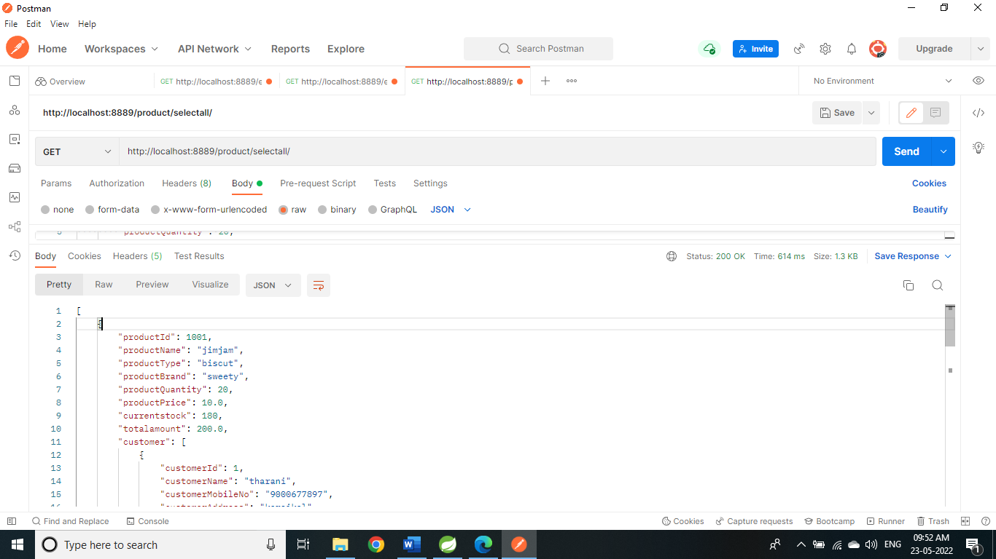
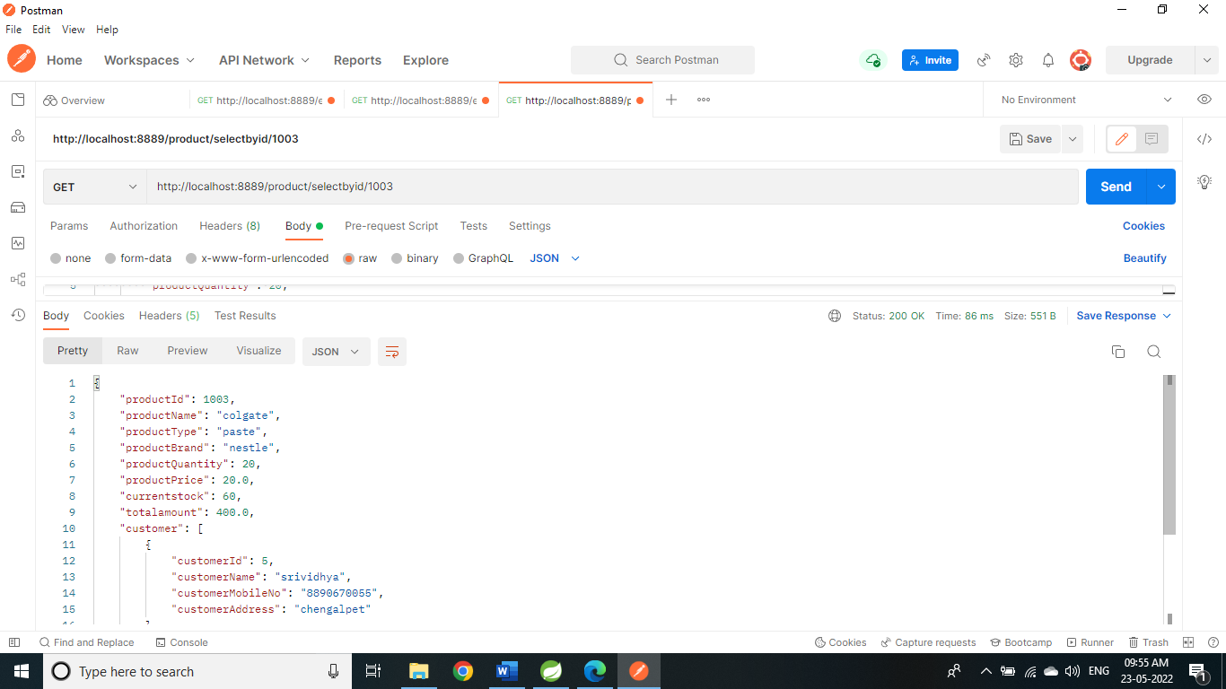
SCREENSHOTS
Get: select all products
http://localhost:8889/product/selectall/
Get: select product by id:
http://localhost:8889/product/selectbyid/1003

Slide 15


SCREENSHOTS
Get: select product by name
http://localhost:8889/product/selectbyname/dove
Select product by type: Get:
http://localhost:8889/product/selectbytype/chocolate

Slide 16


SCREENSHOTS
Select product by brand:
http://localhost:8889/product/selectbybrand/naturally
Select product by quantity:
http://localhost:8889/product/selectbyquantity/50

Slide 17


SCREENSHOTS
Select by price:
http://localhost:8889/product/selectbyprice/40
Post: insertion
http://localhost:8889/product/insertion/

Slide 18


SCREENSHOTS
Update product by id:
Put: http://localhost:8889/product/updatebyid/1002
Delete product by id:
http://localhost:8889/product/deletebyid/1004

Slide 19


SCREENSHOTS
Not found display:
Delete: http://localhost:8889/product/deletebyid/1004
Get : http://localhost:8889/product/selectbyid/7

Slide 20

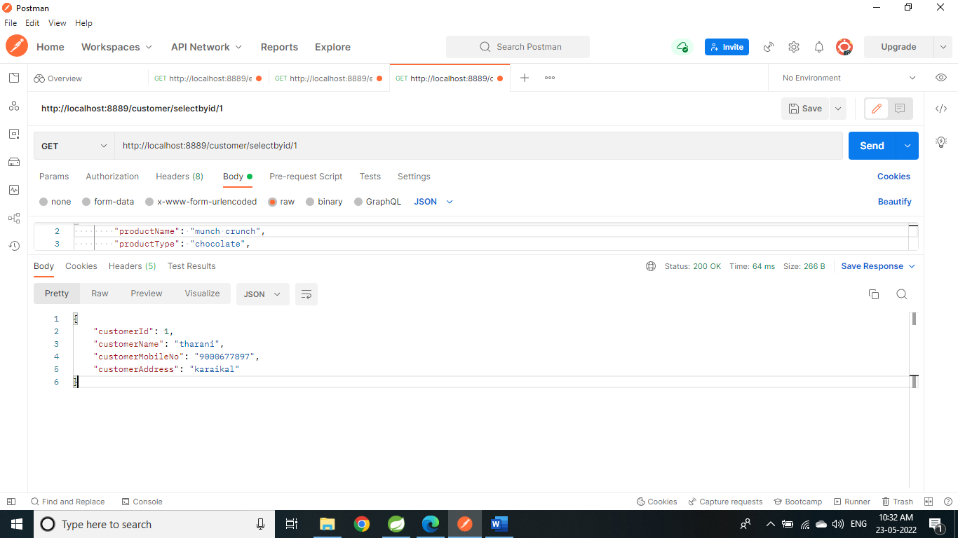
SCREENSHOTS
Customer screen shot:
Get: http://localhost:8889/customer/selectbyid/1
Update: http://localhost:8889/product/updatebyid/9

Slide 21


SCREENSHOTS
Update by id: http://localhost:8889/customer/updatebyid/2
Delete by id: http://localhost:8889/customer/deletebyid/6

Slide 22


SCREENSHOTS
Select by id: http://localhost:8889/customer/selectbyid/6
Update: http://localhost:8889/customer/updatebyid/7

Slide 23

SCREENSHOTS
Input format:
{"productName": "jimjam",
"productType": "biscuit",
"productBrand": "sweety",
"productQuantity": 20,
"productPrice": 10,
"customer": [ {
"customerName": “deepi",
"customerMobileNo": "9000677897",
"customerAddress": "karaikal"
}, {
"customerName": “bismi",
"customerMobileNo": "9900677897",
"customerAddress": “Trichy"
}
] }
Delete: http://localhost:8889/customer/deletebyid/7

Slide 24
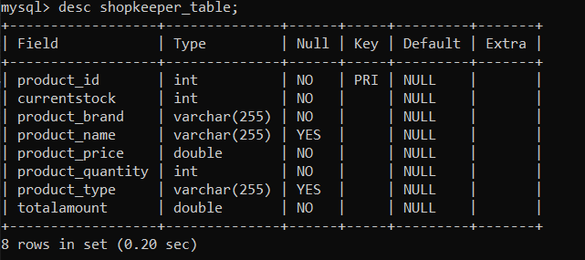
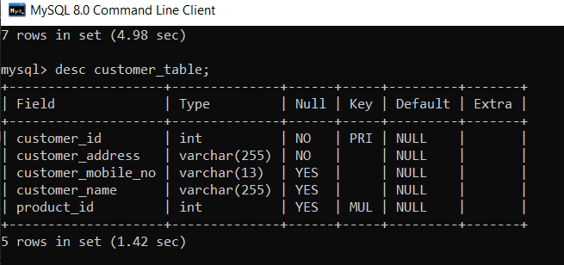
SCREENSHOTS
Shopkeeper_table
Customer_table

Slide 25
CONCLUSION
In Inventory management system we implement using spring boot to build the program in very easy way and using postman to run the program and database to store all the information of the product and customer details.
Fetching details are very easy on this system.

Slide 26
THANK YOU

